Slide 1
From Ajax API to HTMX: Evolving Drupal Interactions
Ruturaj Chaubey – Full Stack Engineer @ QED42
Vighnesh Sadagopal – Full Stack Drupal Engineer @ QED42
Notes:
Open cold - screen already up for the live filter demo. No spoken line yet.

Slide 2
— LIVE
yoursite.example/articles
Filter by: Recipes ▾
mockup — live demo plays here in the browser
Notes:
Silent 15-20s clip: a filter on a Drupal listing page updates instantly as you type. No visible reload, no JS file open anywhere. Let it play, then pause on the result.

Slide 3
That's a live filter.
No JavaScript file.
No Ajax command class.
Just HTML.
Notes:
“That's a live filter. No JavaScript file. No Ajax command class. Just HTML.”

Slide 4
Ruturaj Chaubey
RC
add role / company
Spent a good chunk of the last few years building interactive Drupal sites the traditional way – callbacks and all. Which is exactly why HTMX got me excited.
Notes:
Hi, I'm Ruturaj - [role]. I've spent a good chunk of the last few years building interactive Drupal sites the traditional way, callbacks and all - which is exactly why I got excited when HTMX showed up.

Slide 5
“The future of Drupal UX isn't more JS.
It's smarter HTML, with HTMX.”
Notes:
Land the quote with room to breathe.

Slide 6
Where we're headed
01
Why the Ajax API gets painful at scale
02
HTMX's core idea
03
Mapping that idea onto Drupal's render, routing & caching
04
Live: a form, a filter, a partial update — barely any JS
05
Ajax API vs HTMX, compared honestly
06
Bringing it into a project you already have
07
Where HTMX stands in Drupal core today, and how to contribute
Notes:
Over the next 45 minutes: why the Ajax API gets painful at scale, HTMX's core idea, and how that idea maps directly onto Drupal's render, routing and caching system. Then we watch it work live. After that, an honest comparison, how to bring this into a project you already have, and where HTMX stands in Drupal core today, plus how you can help.

Slide 7
Ajax API: Evolution & Pain Points
02
Notes:
Let's start with where we are today - the Ajax API.

Slide 8
Ajax API: Evolution & Pain Points
— A BRIEF HISTORY
DRUPAL 7
Ajax API unified into a single core framework
DRUPAL 8 → 11
Rebuilt on Symfony's HttpKernel, AjaxResponse extends JsonResponse; interactions become a stack of Commands
Mature. Well-documented. Everywhere in core: exposed filters, autocomplete, modals, inline entity forms.
The right answer for 2011.
Notes:
Drupal's Ajax API isn't new - it's been part of core in its current form since Drupal 7, unified under a single framework. In Drupal 8 through 11, it was rebuilt on top of Symfony's HttpKernel - AjaxResponse extends Symfony's JsonResponse, and interactions are expressed as a stack of Command objects. It's mature, well-documented, and used everywhere in core - exposed filters, autocomplete, modal dialogs, inline entity forms. This isn't a story about a broken system. It's a story about a system that was the right answer for 2011, and is starting to show its age.

Slide 9
— THE MECHANICS
01
An element gets an #ajax property – callback, wrapper, event
02
The callback returns an AjaxResponse built from one or more Commands
03
core/drupal.ajax runs each command client-side; Drupal.behaviors re-attach to the new markup
Notes:
A form/render element gets an #ajax property: callback, wrapper, event. The callback runs server-side and returns an AjaxResponse built from one or more Commands. The client-side core/drupal.ajax library runs each command to mutate the DOM, then Drupal.behaviors re-attach to the new markup.

Slide 10
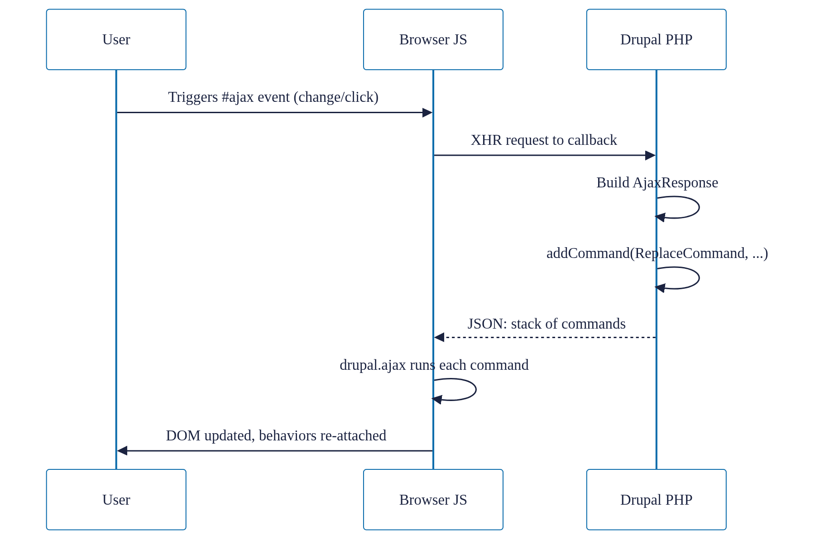
Ajax API request/response cycle
— THE REQUEST/RESPONSE CYCLE
Notes:
Walk through the diagram: user triggers the #ajax event, browser sends an XHR to the callback, server builds an AjaxResponse with commands, drupal.ajax runs each command, the DOM updates and behaviors re-attach.

Slide 11
The #ajax property
— IN CODE
$form['filter'] = [
'#type' => 'select',
'#ajax' => [
'callback' => '::updateResults',
'wrapper' => 'results-wrapper',
'event' => 'change',
],
];
public function updateResults(...) {
$response = new AjaxResponse();
$response->addCommand(new ReplaceCommand(
'#results-wrapper', $form['results']));
return $response;
}
Two files. Two languages. One wrapper ID that has to match exactly or nothing happens. Silently.
Notes:
Two files, two languages, and a wrapper ID string that has to match exactly in both places, or nothing happens - silently.

Slide 12
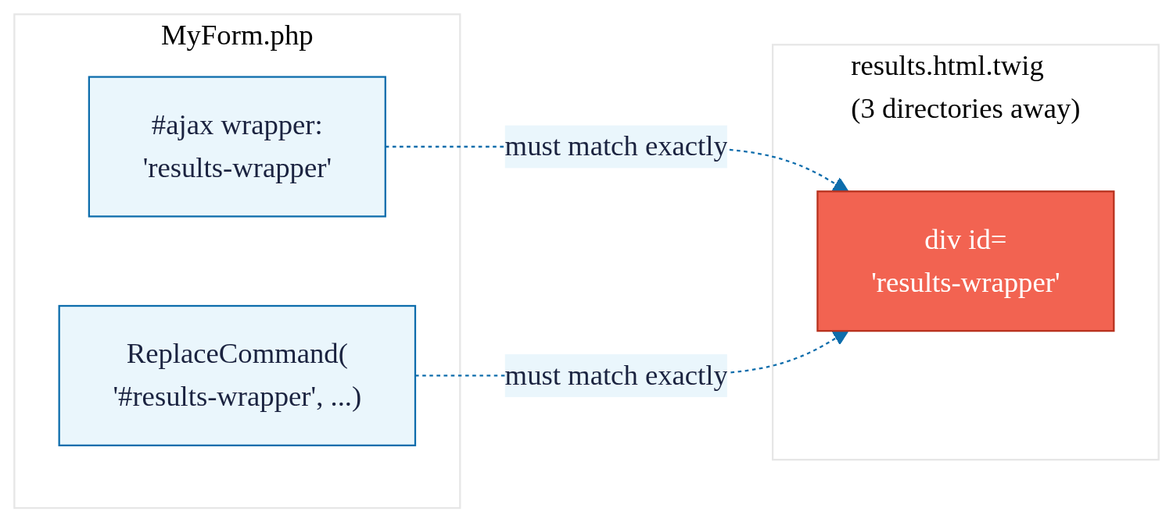
One string, two files, no compiler
— WHERE IT SILENTLY BREAKS
Notes:
One string, defined in two files - the PHP form and a Twig template - in two languages, with no compiler or linter checking they agree. Get it wrong, and nothing throws an error - it just silently doesn't work.

Slide 13
Four pain points
JS COUPLING
Custom interactions need a PHP command plus a matching JS command handler.
COMPLEXITY
An imperative command stack, not a description of the result.
MAINTENANCE OVERHEAD
One typo, no error, silent failure.
DISCOVERABILITY
The markup never says it's interactive.
Notes:
Four pain points: JS coupling, complexity, maintenance overhead, discoverability.

Slide 14
— A TRUE STORY
“40 minutes in devtools. The bug wasn't PHP. It wasn't JS logic. It was one mismatched wrapper ID, three directories away. Nothing threw an error. It just didn't work.”
Notes:
I once spent 40 minutes in devtools debugging an Ajax response that updated one region but silently failed on another. The bug wasn't in the PHP, and it wasn't in the JS logic - it was a mismatched wrapper ID, one string, defined in a template three directories away from the PHP that built the response. Nothing threw an error. It just... didn't work. This is exactly the bug the earlier diagram illustrates.

Slide 15
…the element itself could just describe what it needs?
— SO WHAT IF…
No command classes. No wrapper-ID matching. No second file to go find.
→ next: HTMX
Notes:
So what if, instead of a callback, a command class and a wrapper ID to keep in sync for every interaction, the element itself could just describe what it needs - when this changes, fetch this URL, and drop the result here? No command classes, no wrapper-ID matching, no second file to go find. What would that even look like? (pause, slide transition - next section opens with the reveal: That's not a hypothetical. It's called HTMX...)

Slide 16
That's not a hypothetical.
It's called HTMX.
Built on an idea older than Ajax: hypermedia.
Notes:
That's not a hypothetical. It's called HTMX - and it's built on an idea that's actually older than Ajax: hypermedia.

Slide 17
— THE IDEA
You already know hypermedia. Every <a href> and every <form> you've ever written is a hypermedia control, an element that tells the browser what to fetch and where to put the result. HTMX just extends that vocabulary: any element, any event, any HTTP verb, any part of the page as the target.
Notes:
You already know hypermedia. Every <a href> and every <form> you've ever written is a hypermedia control - an element that tells the browser what to fetch and where to put the result. HTMX just extends that vocabulary: any element, any event, any HTTP verb, any part of the page as the target.

Slide 18
One element. Four attributes.
— IN CODE
<select hx-get="/filter-results"
hx-trigger="change"
hx-target="#results"
hx-swap="innerHTML">
...
</select>
<div id="results">
<!-- server returns just this fragment -->
</div>
One element. Four attributes. The behavior lives right there in the tag — no PHP file to go find, no wrapper ID to keep in sync across two files.
Notes:
One element. Four attributes. The behavior lives right there in the tag - no PHP file to go find, no wrapper ID to keep in sync across two files.

Slide 19
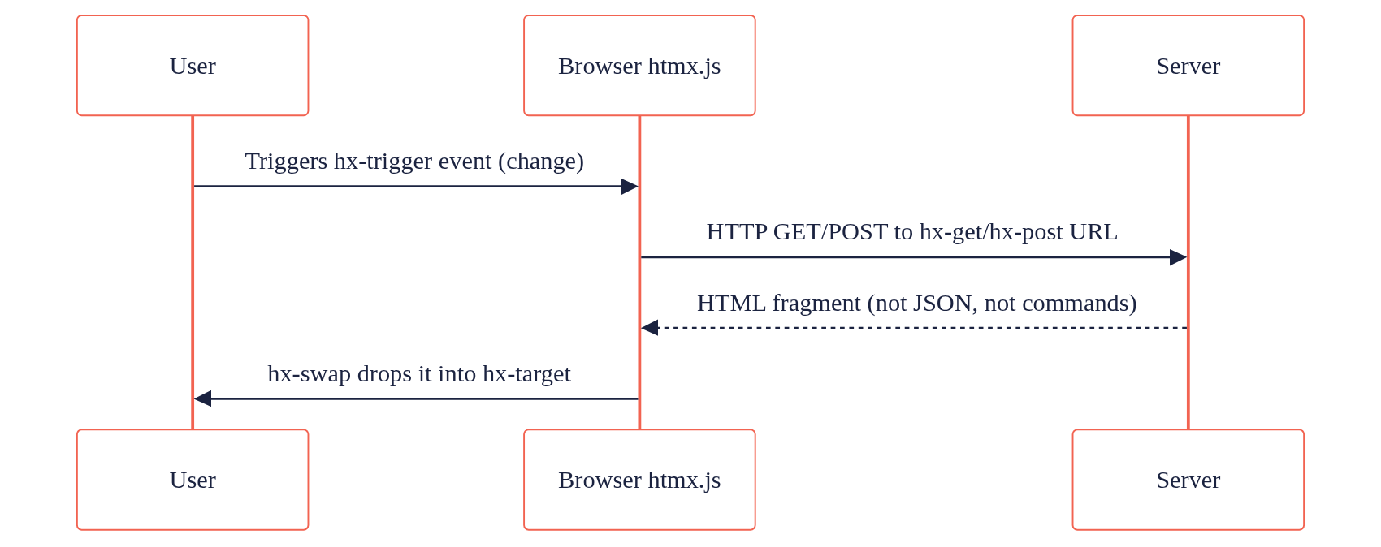
HTMX request/response cycle
— THE REQUEST/RESPONSE CYCLE
Same three participants: user, browser, server. Seven steps in the Ajax version. Four here.
Notes:
Compare that to the version you saw ten minutes ago: same three participants - user, browser, server - but seven steps instead of four.

Slide 20
The response is the next state of the UI — already rendered.
— THE BIGGER IDEA
No separate JSON API.
No client-side templating layer.
HTMX just closes the gap between the first page load and everything after, so both work the same way.
Notes:
There's no separate JSON API here, no client-side templating layer reconstructing HTML from data. The server decides what HTML comes back - same as it always has for the initial page load. HTMX isn't a new architecture. It's closing the gap between 'first page load' and 'everything after,' so both work the same way. That's what 'hypermedia-driven' means - the response is the next state of the UI, already rendered.

Slide 21
Four attributes
VERB
hx-get / hx-post / hx-put / hx-delete
TRIGGER
hx-trigger — any DOM event, not just click/submit
TARGET
hx-target — any element, not just the one that triggered this
SWAP
hx-swap — innerHTML, outerHTML, beforeend, afterbegin, and more
Notes:
Four core attributes: verb (hx-get/post/put/delete), trigger (hx-trigger - any DOM event), target (hx-target - any element), swap (hx-swap - innerHTML, outerHTML, beforeend, afterbegin, and more).

Slide 22
HTMX gives Drupal back a vocabulary
it never lost: Hypermedia.
Next: mapping that onto Drupal's own architecture: render arrays, routing, caching.
Notes:
So HTMX gives Drupal back a vocabulary it never actually lost - hypermedia. The real question is how that maps onto Drupal's own architecture: render arrays, routing, caching. That's next.

Slide 23
Mapping HTMX onto Drupal's Architecture
04
Notes:
Let's map HTMX onto three things Drupal already has.

Slide 24
— THE QUESTION
HTMX doesn't need anything special from Drupal. It needs three things Drupal already has and has had for over a decade.
Notes:
HTMX doesn't need anything special from Drupal. It needs three things Drupal already has, and has had for over a decade: routes, render arrays, and cache metadata. Let's map them one at a time.

Slide 25
A normal Drupal route
— ROUTING
my_module.filter_results:
path: '/filter-results'
defaults:
_controller: '\Drupal\my_module\Controller\FilterController::results'
requirements:
_access: 'TRUE'
options:
_htmx_route: TRUE
hx-get="/filter-results" isn't a special Ajax callback. It's a normal Drupal route with one flag: _htmx_route returns just the main content and its assets, not the whole themed page.
Notes:
An hx-get URL isn't a special Ajax callback - it's a normal Drupal route with one flag. _htmx_route: TRUE tells Drupal to return just the main content and its assets. Without it, you'd get the whole themed page back. No #ajax property, no form-building context required.

Slide 26
The same render array Drupal always returns
RENDER ARRAYS
public function results(Request $request) {
$filter = $request->query->get('filter');
return [
'#theme' => 'item_list',
'#items' => $this->getFilteredItems($filter),
'#cache' => [
'tags' => ['node_list'],
'contexts' => ['url.query_args:filter'],
],
];
}
The same render array every Drupal controller already returns. No AjaxResponse. No Commands. The render pipeline already builds exactly this.
Notes:
The controller returns a render array - the same thing every Drupal controller has always returned. Drupal renders it to HTML. HTMX drops that HTML wherever hx-target points. No AjaxResponse, no Commands - the render pipeline was already built to produce exactly this.

Slide 27
Core does the glue
CORE'S HTMX CLASS
use Drupal\Core\Htmx\Htmx;
(new Htmx())
->get(Url::fromRoute('my_module.filter_results'))
->trigger('change')
->target('#results')
->swap('innerHTML')
->applyTo($form['filter']);
The same four attributes from §3, built in PHP. applyTo() attaches core/drupal.htmx, which loads the response's assets and re-attaches Drupal.behaviors after every swap.
Notes:
And on the markup side, since 11.3 you don't have to hand-write hx attributes. Core's Htmx class builds every htmx attribute from PHP - the same four from the cheat sheet - and applies them to a render element. applyTo() also attaches core/drupal.htmx, which loads any CSS and JS the response needs and re-attaches Drupal.behaviors after every swap.

Slide 28
WHERE THIS PAYS OFF
AJAX API
An AjaxResponse built from Commands doesn't sit in the cache pipeline. You're mostly on your own.
HTMX
A plain render array — cache tags bubble up, contexts vary the response automatically. Caching for free.
Notes:
Here's the part that doesn't exist for the Ajax API without extra work: because this is a plain render array, it gets Drupal's caching for free. Cache tags bubble up automatically, cache contexts vary the response correctly. An AjaxResponse built from Commands doesn't sit in that pipeline the same way - you're mostly on your own for caching an Ajax callback response.

Slide 29
Three things Drupal already gives
RECAP
HTMX asks for | Drupal already has
A URL (hx-get/hx-post) | A route + controller (_htmx_route)
HTML to swap in | A render array
Correctness under caching | #cache tags & contexts
→ next: live demo
Notes:
Three things Drupal already gives every page. HTMX just asks for them directly, without a translation layer in between. Let's see it work.

Slide 30
Live Demo
PLACEHOLDER — dynamic form, filter & partial update, one combined demo built/walked through live in the browser.
05
Notes:
[Live demo - build/walk through here] One combined demo covering the dynamic form, filter, and partial update in a single flow, per the session-flow design note.

Slide 31
Ajax API vs HTMX, Compared Honestly
06
Notes:
HTMX doesn't win everywhere. Let's put the two side by side across four axes, honestly.

Slide 32
DX & PERFORMANCE
DX
AJAX API
More ceremony - but the most proven path for complex multi-step forms and wizards.
HTMX
Far less ceremony. 11.3 rebuilds forms from HTMX requests, but complex multi-step flows are less proven.
PERFORMANCE
AJAX API
JSON command stack, run command by command in the browser.
HTMX
~16kb library; the response is the HTML itself. Up to 71% less JS loaded, per drupal.org.
Notes:
DX: the Ajax API is more ceremony, but it's the most proven path for complex multi-step forms and wizards. HTMX is far less ceremony, and since 11.3 Form API can rebuild forms from HTMX requests - but complex multi-step flows are less proven. Performance: an Ajax response is a JSON command stack that core/drupal.ajax runs command by command. HTMX is a ~16kb library and the response is the HTML itself. Drupal.org reports up to 71% less JavaScript loaded for browser-server interactions with native HTMX in 11.3.

Slide 33
DEBUGGING & PROGRESSIVE ENHANCEMENT
DEBUGGING
AJAX API
Network tab shows an opaque command stack. Wrapper-ID typos fail silently.
HTMX
Network tab shows the literal HTML that got inserted. What you see is what you got.
PROGRESSIVE ENHANCEMENT
Both layer JS onto a real form/link element the same way. Honestly? Close to a wash — neither gets tested with JS off in most real projects.
Notes:
Debugging: in the Ajax API, the Network tab shows an opaque command stack, and a wrapper-ID typo fails silently. With HTMX, the Network tab shows the literal HTML that got inserted. Progressive enhancement: both are progressive by construction, layering JS onto a real form/link element - but honestly, this axis is close to a wash, since both are rarely tested with JS actually disabled.

Slide 34
The verdict, side by side
 | Ajax API | HTMX
DX | More ceremony, most proven for complex multi-step forms | Less ceremony, multi-step patterns still maturing
Performance | JSON command stack, executed client-side | Small library, HTML response, up to 71% less JS
Debugging | Opaque command stack, silent failures | Transparent — see the actual HTML
Progressive enhancement | Built on the same fallback pattern in both — rarely tested either way
Notes:
Four axes, side by side. Progressive enhancement stays a wash on purpose - this isn't a clean sweep for either tool.

Slide 35
Pick the tool for the job, not the trend.
HTMX: where round trips are simple and the UI is a fragment.
Ajax API: where it already works, and for complex multi-step flows, for now. This isn't a replace-everything story.
Notes:
Pick HTMX where round trips are simple and the UI is a fragment. Keep the Ajax API where it already works, and for complex multi-step flows until HTMX patterns there mature. This isn't a replace-everything story. It's a which-tool-for-which-job story. Next: how to actually bring HTMX into a project you already have, without a rewrite.

Slide 36
Incremental Adoption Strategy
07
Notes:
How to actually bring HTMX into a project you already have, without a rewrite.

Slide 37
— NO REWRITE REQUIRED
You don't rip out the Ajax API to start using HTMX. They coexist on the same page - HTMX doesn't touch anything #ajax owns.
Notes:
You don't rip out the Ajax API to start using HTMX. They coexist on the same page - HTMX doesn't touch anything #ajax owns. Here's how to actually bring it into a project you already have.

Slide 38
Already in core
— HTMX SHIPS WITH DRUPAL 11.3+
// Using the Htmx class? It attaches core/drupal.htmx for you.
// Hand-writing hx-* attributes in Twig? One line:
$build['#attached']['library'][] = 'core/drupal.htmx';
Drupal 11.3+ ships core/htmx and core/drupal.htmx. No library definition, no CDN, no build step.
Notes:
On Drupal 11.3 and up there's nothing to install. Core ships htmx as core/htmx, plus core/drupal.htmx for the Drupal glue: asset loading and behaviors. If you use the Htmx class, it attaches the library for you. If you hand-write hx attributes in Twig, it's one #attached line. No library definition, no CDN, no build step.

Slide 39
PICK CANDIDATES, DON'T DO A SWEEP
LEAVE IT
Existing Ajax API code that already works. No sweep, no module-wide rewrite.
HTMX CANDIDATES
New interactive spots, or the small annoying ones - a filter, a load-more pager, an autocomplete list.
<nav hx-boost="true">
A low-effort on-ramp: links and forms inside become HTMX requests. Start with one region - each boosted request still swaps the whole <body>, so test page-level JS like the toolbar.
Notes:
The Ajax API code that already works - leave it. HTMX is for new interactive spots, or the small annoying ones: a filter, a load-more pager, an autocomplete list. hx-boost is a low-effort way to try it - links and forms inside the boosted element become HTMX requests automatically. Scope it to one region first. Each boosted request still swaps the whole body, so test page-level JS like the toolbar and BigPipe.

Slide 40
Which tool, when
THE RULE OF THUMB
Situation | Reach for
New interactive feature | HTMX by default.
Existing, working Ajax API code | Leave it alone.
Complex multi-step forms (wizards, heavy Form API flows) | Keep them on the Ajax API for now, per §6's verdict.
Notes:
New interactive feature: HTMX by default. Existing, working Ajax API code: leave it alone. Complex multi-step forms - wizards, heavy Form API flows: keep them on the Ajax API for now, per §6's verdict.

Slide 41
A second tool in the same box, not a rewrite.
— THE TAKE
Use what core ships, pick a handful of low-risk candidates, boost one region to get a feel for it. No migration weekend required.
→ next: current status + contributing
Notes:
Use what core ships, pick a handful of low-risk candidates, boost one region to get a feel for it. No rewrite, no migration - just a second tool in the same box as the Ajax API. Next: where this actually stands in Drupal core today, and how you can help move it forward.

Slide 42
Current Status + How to Contribute
08
Notes:
So, where are we today?

Slide 43
WHERE THINGS STAND TODAY
This isn't a someday story - HTMX arrived in core in 11.2 and became fully featured in 11.3, as part of an active initiative to replace the Ajax system.
CORE INITIATIVE
"Gradually replace Drupal's AJAX system with HTMX" - still active. Both APIs run side by side until contrib has time to convert.
CONTRIB MODULE
drupal/htmx adds extra tooling on top of core - 1,156 sites already using it.
Up to 71% less JavaScript loaded for browser-server interactions with native HTMX, per drupal.org.
Notes:
This isn't a someday story. HTMX came into core as a dependency in 11.2 and became fully featured in 11.3, as part of an active initiative to gradually replace the Ajax system. Both APIs are running side by side right now, on purpose, while contrib gets time to convert. And the payoff is measurable: drupal.org reports up to 71% less JavaScript loaded for browser-server interactions.

Slide 44
BOTH APIS, ON PURPOSE
Same incremental philosophy as §7 - just scaled up to core. Full deprecation waits until contrib has had real time to convert.
NOT TO BE CONFUSED WITH
EXPERIENCE BUILDER
Page/layout building - not interaction plumbing.
SINGLE DIRECTORY COMPONENTS
Component authoring - not interaction plumbing.
Notes:
Core is keeping the old Ajax API and the new HTMX path running together on purpose - full deprecation waits until contrib has had real time to convert. That's the same incremental philosophy from §7, just at the core level instead of your project's.

Slide 45
How to contribute
CORE INITIATIVE
Plan issue + POC issue in the core queue.
CONTRIB MODULE
drupal.org/project/htmx issue queue.
COMMUNITY
#htmx on Drupal Slack.
ENTRY POINTS
Triage issues, convert one #ajax callback, write docs, build a case study.
Notes:
Triage issues, convert a #ajax/Command usage to HTMX and report back, write docs/examples, build real-world case studies like this talk. The core initiative issue queue, the contrib module issue queue, and the #htmx channel on Drupal Slack are where the work happens.

Slide 46
It's not waiting on permission.
— THE CLOSE
Already in core, actively being worked, and it needs hands. On 11.3? Convert one #ajax callback and see how it feels.
→ next: wrap-up + Q&A
Notes:
This isn't waiting on permission - it's already in core, it's actively being worked, and it needs hands. If you're on 11.3, it's already on your site: go convert one #ajax callback in your own project and see what it feels like.

Slide 47
Thank you!
Questions?
Ruturaj Chaubey – Full Stack Engineer @ QED42
Vighnesh Sadagopal – Full Stack Drupal Engineer @ QED42
Notes:
Thank everyone for coming, then open the floor for questions. Backup answers for likely questions are in docs/8-qa-backup.md.

